Slide 1
Computer Principles for Programmers
History and Types of Computers and Programming
Notes:
A physician, a civil engineer, and a computer scientist were arguing about whose was the very first profession in the world. The physician remarked, "Well, in the Bible, it says that God created Eve from a rib taken out of Adam. This clearly required surgery, and so I can rightly claim that mine is the first profession."
The civil engineer said, "Wait, earlier in Genesis, it states the first three of God’s creative acts were to separate the chaos into the heavens, the seas, and the land. This was civil engineering. Therefore, fair doctor, you are wrong: mine was the first profession."
The computer scientist leaned back in her chair, smiled, and said, "Ah, but who do you think created the chaos?"

Slide 2
News of the Week

Slide 3
Lecture
How did we get here? Computer History
What do we mean by Hardware?
What do we mean by Software?
Do we really need all those programming languages?
Notes:
Programming Overview:
What do we mean by Algorithm, Code, and Programming?
Short history of Programming Languages.
What do we mean by Low-Level Programming and High-Level Programming
Types of Programming Languages (Compiled, Interpreted, Scripting, Embeddable, etc.)
Discussed in Week 6
What do we mean by an Application Software? How does it work along with a System Software?
What do we mean by a System Software/Operating System?

Slide 4
Activity
Questions about hardware and software concepts.
Do any two or do one at length.
There are no right answers, just good arguments.
Option to ask & answer your own question, and it must be an interesting question.

Slide 5

History of Discovery
Notes:
A new idea can change how we think of the world. Watch this animation of our solar system…
“Discovery consists of seeing what everybody has seen and thinking what nobody has thought.” Albert Szent-Gyorgyi (Nobel Prize for Medicine, 1937)
Yet, it is very hard to think what no one has thought because:
* “We see only what we know.” Geothe 1749-1832. German literature & science author, statesman
* We do not see things as they are, we see things as we are.
500 years ago, people saw the sun rise in the east and set in the west. At night, they saw the moon and stars move about the sky. They believed that the earth was the center of the universe because they saw the celestial bodies revolve around the earth. But now, we believe the earth goes around the sun, that there is no center of the universe, and the sky looks…exactly the same to us as it did to our ancestors. The sun still rises in the east and sets in the west but everything is different. We don’t believe what we see, we see what we believe.
The development of computer hardware, software, and much else, proceeds like this. With every new invention and new discovery, we find out "the future is not what it used to be".
https://quoteinvestigator.com/2012/12/06/future-not-used/
"We wanted to go to the moon, so we went there." – Muhammad Yunus, Nobel Peace Prize Laureate, 2006
————————–
T. S. Eliot wrote
"We shall not cease from exploration, and the end of all our exploring will be to arrive where we started and know the place for the first time."
“Only those who will risk going too far can possibly find out how far one can go.”
“If you aren’t in over your head, how do you know how tall you are?”
“What we call the beginning is often the end. And to make an end is to make a beginning. The end is where we start from.”
“The very existence of libraries affords the best evidence that we may yet have hope for the future of man.”
“Where is the Life we have lost in living? Where is the wisdom we have lost in knowledge? Where is the knowledge we have lost in information?”
“Success is relative. It is what we make of the mess we have made of things.”
https://www.huffpost.com/entry/ts-eliot-quotes_n_3996010
Heliocentrism vs Geocentrism, an 11 second animation (conceptually if not astronomically, accurate)
https://www.youtube.com/watch?v=waexG16WZrE
https://www.wired.com/2014/04/how-do-we-know-the-earth-orbits-the-sun/

Slide 6
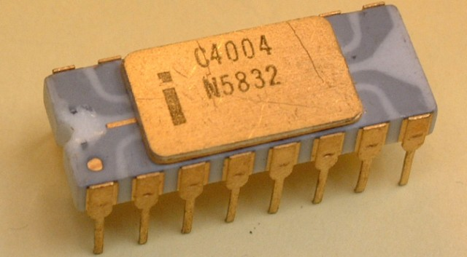
History of Invention
“But what ... is it good for?”
Engineer at the Advanced Computing Systems Division of IBM commenting on the microchip in 1968.
Notes:
A new thing is invented:
“But what ... is it good for?”, said by a very smart Engineer at the Advanced Computing Systems Division of IBM commenting on the microchip in 1968.
It is hard to see the future from the present.

Slide 7
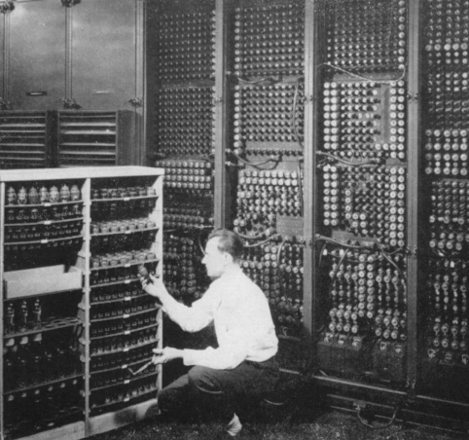
Early Computers
Notes:
Counting devices like the abacus have been around for about 5,000 years. Ten fingers and toes have been around even longer.
Calculating devices were first invented in the 17th C.
For many of us,
hardware is having the latest smartphone,
hardware is all fast enough, it’s the network that is slow.
What follows is just a little perspective on computer history illustrated by major milestones.
For more info, see http://io9.gizmodo.com/the-history-of-early-computing-machines-from-ancient-t-549202742 and a hundred other websites for more info.
https://www.autodesk.com/products/eagle/blog/computers-around-century-ago/

Slide 8

NACA (NASA) High Speed Flight Station Computer Room (1949)
Notes:
Do you see any computers?
No? There are six of them…all with nice hairdos. The guy is likely the supervisor handing out assignments because he is not a good enough mathematician.
From the early 17th C until the mid 20th C, a computer was “one who computes”: a person who applied mathematical formulae procedurally to solve complex problems.
They used calculators (“Friden” in foreground) but people did the computing. Those people were usually women, in this case likely doing differential calculus. See the 2016 movie Hidden Figures.
https://en.wikipedia.org/wiki/Human_computer

Slide 9
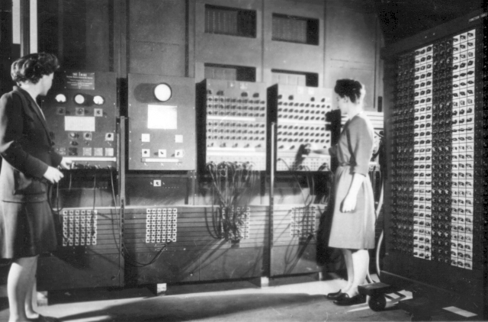
ENIAC (Electronic Numerical Integrator And Computer) 1946
Notes:
ENIAC is considered the grandfather of computers, the world’s first all-digital, Turing-complete, general-purpose computer. It filled a 20-foot by 40-foot room, had 18,000 vacuum tubes, 3,000 switches, and weighed 60,000 pounds. ENIAC took 20 seconds to do a differential calculus problem that took a real computer in those days–a math expert with a calculator, usually a woman–20 hours to do. This is partly why "computing" was considered clerical work.
The ENIAC was on the cover of Time magazine with the headline 'Giant Brains.' Today, the same computational power is used in greeting cards that play you a tune. Imagine the reaction if Time magazine had predicted: fifty years in the future, millions of hand-held, self-powered ENIACs will be bought for a few dollars at the corner store, used for 30 seconds and thrown away. No one would have believed you. Who could envision a microprocessor in a greeting card after seeing an ENIAC?
https://www.youtube.com/results?search_query=Women+of+ENIAC
Programmers Betty Jennings (left) and Fran Bilas (right) operate the ENIAC's main control panel. Six women mathematicians {Kathleen McNulty Mauchly Antonelli, Jean Jennings Bartik, Frances Snyder Holberton, Marlyn Wescoff Meltzer, Frances Bilas Spence, Ruth Lichterman Teitelbaum}, known as the ENIAC Six, programmed the ENIAC by laboriously setting switches and plugging cables. There was no manual how to use the ENIAC, only blueprints and wiring diagrams. They invented modular programming and subroutines.
Frances Holberton (nee Snyder) later developed the first data sorting algorithm which greatly simplified a common but laborious task, she developed the decision tree for the binary sort function; her sort-merge generator "inspired the first ideas about compilation"; she invented breakpoints for computer debugging. Holberton developed the C-10 instruction set for BINAC said by Grace Hopper to be "the basis for all subsequent programming languages" (Grace also said Holberton "was the best programmer" that she had ever known. Holberton designed control panels that put the numeric keypad next to the keyboard. She was a crucial member of the team developing COBOL, the business programming language and FORTRAN (with Grace Hopper). On her first day of classes at the University of Pennsylvania, Holberton's math professor asked her if she wouldn't be better off at home raising children. She was finally granted an IEEE Computer Pioneer Award in 1997. Jean Bartik did not receive the same award until 2009.
IEEE, pronounced "Eye-triple-E," stands for the Institute of Electrical and Electronics Engineers. It is the world's largest technical professional association.
The ENIAC Six were not invited to the official announcement party for the ENIAC computer.
Five years later, the ENIAC lead to the UNIVAC in 1951, the first commercial computer for business and government applications. UNIVAC is an acronym for UNIVersal Automatic Computer. Kathleen (Kay) McNulty and Jean Bartik and Betty Holberton were instrumental in the UNIVAC's design and success.
There's much more, see https://vimeo.com/107667129 and http://eniacprogrammers.org/
https://en.wikipedia.org/wiki/ENIAC and https://en.wikipedia.org/wiki/Betty_Holberton
http://www.nytimes.com/2001/12/17/business/frances-e-holberton-84-early-computer-programmer.html
http://fortune.com/2014/09/18/walter-isaacson-the-women-of-eniac/
https://iq.intel.com/how-female-eniac-programmers-pioneered-the-software-industry/
http://hopl.info/showlanguage.prx?exp=5442
http://www.cbi.umn.edu/iterations/norberg.pdf
https://spin.atomicobject.com/2016/07/31/eniac-programmers/
https://www.digitaltrends.com/computing/remembering-eniac-and-the-women-who-programmed-it/
https://www.computer.org/csdl/magazine/an/1996/03/man1996030013/13rRUypp59F
"We had a tube fail about every two days and we could locate the problem within 15 minutes." -- J. Presper Eckert, 1946 (the other ENIAC designer)
I wish I could go two days without some kind of a computer problem or fix anything within 15 minutes.
ENIAC's longest continuous period of operation without a failure was 116 hours (close to five days).
When's the last time your computing device ran that long without a reboot or a problem?

Slide 10

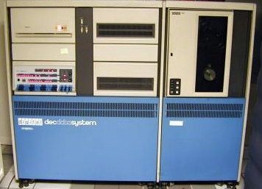

Mainframes, minis, and mid-range
IBM Power
DEC PDP-11/70 1970s 4MB RAM
Google search, PayPal, big data & analytics. Clouds: Tencent, Google, MS Azure, Alibaba
IBM z15, 190 cores, 40TB RAIM (2019) Mainframes run 68% of the world’s production workloads at 6% of total IT costs
Investment protection: backward compatibility with 1960s-era IBM S/360 mainframes
Notes:
Large scale computer architecture was established by the IBM/360 “mainframe” or “big iron” in the 1960’s and continues today. A ‘big iron’ mainframe is called that perhaps because the CPU and magnetic-core memory -- made of tiny iron rings -- were contained in a big frame, the MAIN frame. Current IBM mainframes are known as the Z series where Z stands for zero downtime or Seven 9s of availability, 99.99999 or 3 seconds of unscheduled downtime a year. They are the most powerful business computers extant. A Z15 is its own cloud.
Note: one z15 core = 5.88 x86 cores, RAIM = Redundant Array of Independent Memory
Most of world’s money flows through mainframes which are used in banking, insurance, transportation, financial services, and government. These workloads are heavily transactional, data intense, and massive in scale. Computing platform must be secure, continuously available, and be compatible with old software. IBM calls it investment protection. If they upgrade your mainframe to make it better and faster, they will not break your existing software…unlike a lot of other platforms.
https://www.zdnet.com/article/ibm-z15-release-shines-light-on-how-much-is-still-being-run-on-a-mainframe/
Replacing mainframe workloads would require significant numbers of distributed systems with significant uplifts in management complexity and cost.
IBM's largest z15 can:
* process 19 billion encrypted transactions per day or ~220,000/second, * execute 1 trillion web transactions per day or over 11,000,000 per second in up to 2.4 million Linux containers (2.3 X more efficient than x86 Linux)
* do 5x more transactions a year than Google does searches.
* run 85 percent of all credit card transactions, >$8 trillion a year
* do 29 billion ATM transactions per year or $5 billion a day
* book 12 billion passenger flights a year
* encrypt data 36X faster than x86 platforms at just 5% of the cost.
* run Java workloads 50% faster than x86 alternatives and can run >1,000 concurrent NoSQL databases.
-----------------
In the 1970s, “minicomputers” arrived. They were much more affordable than mainframes and began appearing in small to medium sized businesses to handle their smaller workloads. Various manufacturers created systems running versions of UNIX. The Digital Equipment Corporation’s PCP-11 (Programmed Data Processor) was a landmark machine in the 1970s and cost about 10% of a mainframe.
IBM's AS/400 was introduced in 1988 with a revolutionary object-based OS using single level storage. The platform is now known as "IBM Power" servers running *nix or IBM i--the OS designed to replace the mainframe OS.
In 4th semester, students will take a course using this platform you've never heard of. Industry has heard of it:
Google uses IBM Power systems to run their search engine. POWER9-based systems can transfer data up to 9.5 times faster than an x86 Linux cluster.
IBM Power has more business loyalty to that platform than any other.
Like the IBM mainframes, this platform has upward or forward compatibility. You can run a program created for the AS/400 in 1988 on a Power Systems server today with little or no changes. It has five and a half nines reliability 99.9996 ~2.1 minutes of unscheduled downtime per year, 1/5 the cost of a comparable x86 Linux/Oracle platform -- 88% of IBM Power Systems running Linux experience fewer than one unplanned outage per server, per year. IBM Power TCO (total cost of ownership) is 1/3 of x86 Linux/Oracle platform. Has a built in Virtual Machine Hypervisor which can run up to 1024 Logical Partitions being any combination of IBM i, IBM AIX, or Linux OS instances.
-- Scalable from 4 cores to 256, secure, runs Java, .NET, PHP, C/C++, web services, virtualization, runs Linux applications with minimal porting (i.e. same as moving Linux apps from one distro to another). Has sophisticated backup and recovery methods for very high reliability and availability; can scale up to >100,000 users. https://dancingdinosaur.wordpress.com/tag/6-nines-99-9999-availability/
In the 1980's, Microsoft Canada ran their software and manuals distribution application on an IBM AS/400 computer.
https://en.wikipedia.org/wiki/IBM_i
https://www.ibm.com/it-infrastructure/power/os/ibm-I
https://www.ibm.com/it-infrastructure/us-en/resources/power/i-strategy-roadmap/
http://ibmsystemsmag.com/Power-Systems/01/2019/lpars-linux
https://www.forbes.com/sites/patrickmoorhead/2018/03/19/headed-into-its-fifth-year-openpower-has-momentum-into-the-power9-generation/
http://ibmsystemsmag.com/blogs/aixchange/march-2018/power9-attracts-a-big-customer/
https://seasoft.com/blog/why-should-companies-run-sap-on-ibm-i/
https://www.eweek.com/innovation/ibm-i-the-most-amazing-ibm-product-you-ve-never-heard-of
http://archive.ibmsystemsmag.com/blogs/you-and-i/september-2017/promoting-ibm-i-tco-tca-reliability-and-strategy/
https://www.itjungle.com/2018/09/24/ibms-own-positioning-of-power-systems-revealed/
https://www.helpsystems.com/blog/as400-dead
https://www.nextplatform.com/2019/09/10/microsoft-brings-ibm-power-iron-to-azure-cloud/
There are and have been other computer manufacturers besides IBM (https://en.wikipedia.org/wiki/BUNCH) however IBM has been the mainstay of the business computing world primarily because their platform upgrades do not break existing software. IBM was criticized as “Inferior But Marketable” or "It's Better Manually". IBM was never at the bleeding edge of computing in terms of their commercial offerings. But IBM’s products worked reliably and had the industry’s best support. “Nobody ever got fired for buying IBM.” If you chose IBM and there was a problem, well, it was a reasonable decision and IBM could be trusted to fix it. But if you chose another computer company that didn't work out, your boss blamed you.
IBM has been on the bleeding edge of R&D for some time. 2018 was the 26th consecutive year that IBM topped the annual list of U.S. patent recipients when IBM inventors received a record 9,100 patents. Nearly half of the patents granted to IBM in 2018 are pioneering advancements in AI, cloud computing, cybersecurity, blockchain and quantum computing.
https://www.google.com/search?q=ibm+patents+in+2018
——————–
Search https://books.google.com/ngrams for "big iron". The peak of the term's usage was in 1943 … don't know why.
https://en.wikipedia.org/wiki/Magnetic-core_memory
To process almost 30M personal income tax returns in Canada -- a complex process in a short time -- takes a lot of computing power.
https://www.canada.ca/en/revenue-agency/corporate/about-canada-revenue-agency-cra/individual-income-tax-return-statistics.html
http://www.oag-bvg.gc.ca/internet/English/parl_oag_200511_03_e_14941.html#ch3hd3d
Why Mainframes?
Low TOC (Total Cost of Ownership) for Enterprise scale computing.
83% of clients report near 100% availability.
http://ibmsystemsmag.com/mainframe/business-strategy/competitive-advantage/itic-reliability-survey/
Secure: z15 encrypts every level of the system, then stores everything inside encrypted containers. If the system detects an attack like malware or other intrusion, it has been designed to shut itself down automatically.
Has extensive external input – output facilities. Can support hundreds of thousands of users and millions of connections.
Has multiple peripheral processors to handle slow I/O and cryptography, and the slightly slower control of memory while up to 190 CPUs are busy with computational tasks. i.e. very high performance.
Z15 introduced Sept.2019, >3,000 patents issued or in process for the new platform.
RAIM = Redundant Array of Independent Memory which utilizes additional memory modules and striping algorithms to protect against the failure of any particular module and keep the memory system operating continuously.
IBM's Storage Array keeps the super fast Z15 busy. It can have from 12 TB up to almost 6,000 Terabytes (6 Petabytes) of flash memory making data transfer from secondary storage to RAM 5X faster than its closest competition and resulting in 50% reduction in transaction time on an IBM Db2 real-world workload.
Z15 Price range USD$250,000 to USD$5 million
190 z15 cores = 1,117 high-performance x86 cores.
A z/OS address space (16 exabytes) is 4,000 times the size of an X86-64 which can theoretically address 4 petabytes.
https://www.ibm.com/it-infrastructure/z/news
https://www-01.ibm.com/common/ssi/cgi-bin/ssialias?subtype=ca&infotype=an&supplier=760&letternum=ENUSJG19-0039
https://newsroom.ibm.com/2019-09-12-IBM-Unveils-z15-With-Industry-First-Data-Privacy-Capabilities
https://www.sdxcentral.com/articles/news/ibm-injects-cloud-innovation-into-its-z15-mainframe/2019/09/
https://www.forbes.com/sites/moorinsights/2019/09/12/is-this-the-fastest-storage-array-in-the-world/#766278fda237
http://relevantz.ibmsystemsmag.com/
http://archive.ibmsystemsmag.com/mainframe/resources/big-iron-the-mainframe-story/
https://newcomputermuseum.org/guide/mainframe/
Everything stored on the machine from RAIM to persistent storage is encrypted for security (IBM's pervasive data encryption strategy) and compressed for performance. A compression coprocessor results in improved memory and disk efficiency due to less data being transferred between slow persistent storage to faster RAM, to very fast CPU caches where it is uncompressed (and decrypted using on-chip Cryptography) on its way to CPU registers. Improved internal I/O bandwidth contributes greatly to overall performance. Applications are rarely CPU bound because it is easy and cheap to get more CPU. IBM Power Servers come with extra CPUs which can be turned on as needed.
https://www.cio.com/article/3268046/enterprise-architecture/big-iron-how-ibm-z-mainframes-fit-in-the-digital-age.html
https://www.ibm.com/it-infrastructure/linuxone
https://en.wikipedia.org/wiki/IBM_mainframe
https://en.wikipedia.org/wiki/IBM_zEnterprise_System
http://ibmsystemsmag.com/mainframe/resources/big-iron-the-mainframe-story/
https://www.theregister.co.uk/2017/07/17/ibm_latest_mainframe_z14/
http://www.planetmainframe.com/2017/07/new-ibm-z14-secure-flexible-powerful-analytical-ever/

Slide 11
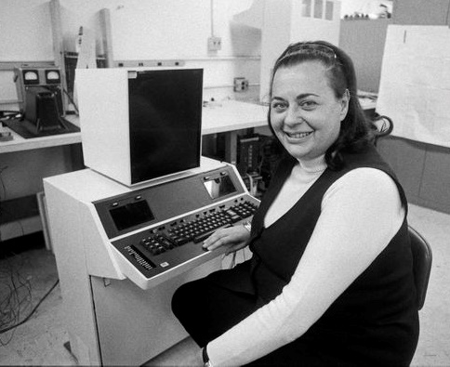
Large Systems & Special Purpose Devices
Evelyn Berezin, computer engineer
1951 – computer logic designer
1962 – United Airlines reservation system: 60 cities, 1 sec. response time, no central system failures in 11 years of operation
1971 – first word processor
Nine patents 1959 – 1969
Evelyn at the 'Data Secretary' the first word processor
Notes:
Large systems grew on IBM mainframes throughout the 1960s with advancing communication systems. Special purpose devices proliferated during the 1970s.
Berezin = BEAR-a-zen
Berezin designed networks and computer systems with no training because she could not get a job as a physicist in the late 1940s / early 1950s (despite physics research going gangbusters then). And there was no training to design networks and computer systems because they were being invented then.
1962 - United Airlines reservation system was one of the largest computer systems at that time. She designed it including the central system with three independent, linked processors.
IBM and American Airlines SABRE system went live with an experimental system in 1960 which they say was the first. That's a fact but not the Truth. SABRE launched at a similar scale a year after United Airlines' system.
It wasn't easy being a woman in the industry. In 1960, Berezin says she was offered a job at the New York Stock Exchange, as a vice president managing the computer system that handled their communications. But then the offer was retracted by the board of directors.
"And I said, what? Why? At the time, I was probably one of the very few people in the world who could design a machine for them. I was really just stunned."
The man who offered her the job apologetically explained, "They said that you were a woman, you'd have to be on the stock market floor from time to time. And the language on the floor was not for a woman's ears."
"I had worked in laboratories all my life," Berezin said. "I had seen practically naked men working on these hot machines. I said, what in the world was he talking about? But there was no way I could get back to them. So that tells you the situation of women at the time."
1971 – first word processor, the Data Secretary. It required leading edge hardware. Her company, Redactron, had to design and build some of its own computer chips. They sold 10,000 machines for US$8,000 each or ~US$45,000 in 2018 dollars, almost US$0.5 Billion sales in the 7 years of the company in 2018 dollars.
Note that the HP-35 scientific calculator sold for US$395 in 1972 which is $2,372.90 in 2018 dollars.
https://www.nytimes.com/2018/12/10/obituaries/evelyn-berezin-dead.html
https://www.computerhistory.org/fellowawards/hall/evelyn-berezin/
https://search-proquest-com.libaccess.senecacollege.ca/docview/2157708740?accountid=28610
https://www.npr.org/2018/12/12/676024428/evelyn-berezin-computer-scientist-behind-groundbreaking-word-processor-dies-at-9
https://www.npr.org/sections/alltechconsidered/2014/10/06/345799830/the-forgotten-female-programmers-who-created-modern-tech
https://www.theglobeandmail.com/business/technology/article-evelyn-berezin-93-was-the-creator-of-the-first-computerized-word/?utm_medium=Newsletter&utm_source=Tech,%20Telecom%20&%20Media&utm_type=text&utm_content=TechTelecomMedia&utm_campaign=145912599

Slide 12
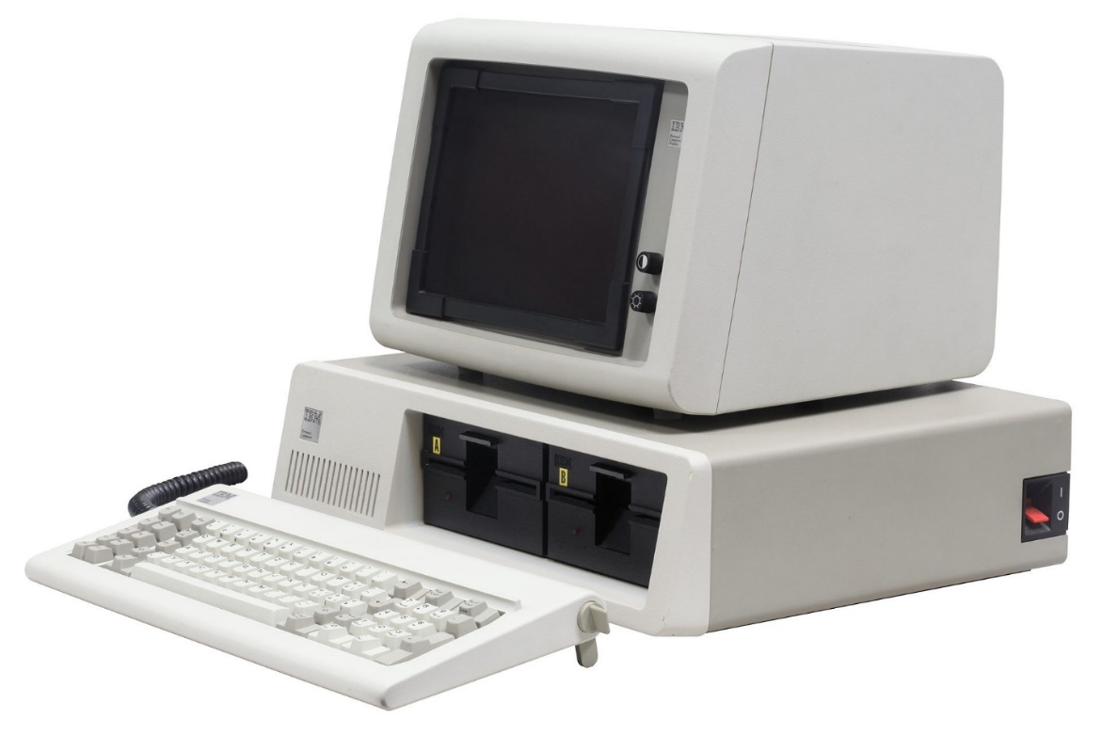
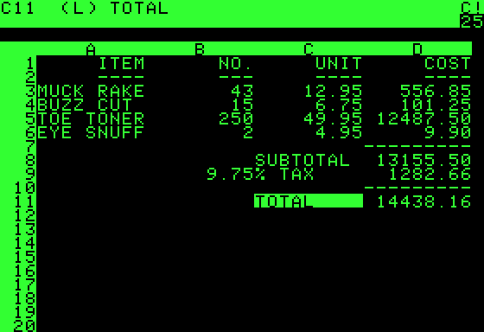
IBM PC, Model 5150, 1981 & VisiCalc
VisiCalc, the first "killer application"
Notes:
Today, personal computing means smartphones and tablets. Personal computing started in the mid 1970’s but became credible in 1978 with VisiCalc running on the Apple II because no other hardware could run the first “killer application”, the VisiCalc spreadsheet program. “VISICALC represented a new idea of a way to use a computer and a new way of thinking about the world. Where conventional programming was thought of as a sequence of steps, this new thing was no longer sequential in effect: When you made a change in one place, all other things changed instantly and automatically.” — Ted Nelson
On August 12, 1981, IBM introduced its smallest, lowest-priced computer system, the IBM Personal Computer, forever known as the "PC". You can see one in Tim McKenna’s office, DB2095. It cost CDN$6,600 for the full system including the printer. In 2017 dollars, the system would cost $16,666. Then and now, about the price of a sub-compact car. Remember software “investment protection” on the mainframe? The IBM imprimatur extended to the PC. With a number of competing platforms, it was IBM’s acceptance in the business community that helped established the PC as standard platform for personal business computing. That, and the disaster of the Apple III at the same time.
When the IBM PC debuted, Microsoft was the only company that offered operating system, programming language, and application software for the new computer. Bill Gates had convinced IBM to agree that PC-DOS (Disk Operating System) would not be an IBM exclusive and allowed Microsoft to market MS-DOS. This paved the way for the PC clone industry. IBM used commodity hardware components but did create the unique BIOS (Basic Input Output System) yet it was soon reverse engineered. In 1983, Lotus 1-2-3, the spreadsheet/database/graphical charts program, took full advantage of the IBM PC’s hardware capabilities (unlike VisiCalc). The combination of Lotus 1-2-3 and IBM/Lotus compatible machines made it the standard tool of business. Apple almost died as a result. VisiCalc did die but it is fondly remembered.
PCs slowly replaced terminals on people’s desks connected to mainframes and radically changed business IT.
IBM's initial five-year forecast was for just over 250,000 PCs. IBM sold more than 12X as many: 3 million in that time. They thought 80 million PCs would be sold by the end of the century. They missed that forecast too, by more than 500 million or only a factor of 6.
The Original IBM PC 5150 - the story of the world's most influential computer – https://www.youtube.com/watch?v=0PceJO3CAGI
In the last 60 years, computers as we know them, have become continually better, faster, and cheaper. Sure your iPhone 6 has 1,000 times more flops (Floating Point Operations) than a Cray-1 supercomputer from the 1970s but nobody researching high-energy physics today is doing it on an iPhone. Raw calculating power does not equal usefulness.
Think about what the computers are used for. When does hardware matter? This is part of your activity task today.
For large scale computing, it’s mainframes.
For high-performance computing (e.g. gaming or video editing), hardware really matters. E.g. how many frames-per-second is your GPU rendering?
For those running multi-player networked games, It appears you are playing together with others in real time but the computing model is hiding network latency. The model is extremely sophisticated and encompasses, well, everything: hwr, swr, network, client, server.
For those running a web browser for email and surfing, a Chromebook will do.
For my mother, an iPad is best. (For me, too. It reduces tech support calls.)
For most of us at this college, a mid-range laptop will do our school work.
For the IoT, the software footprint may be critical on limited devices.
For mobile, battery life is a real constraint and is affected by cpu usage, screen writes, transmitter usage.
In the latter two cases, platform and efficient software matters.
So consider hardware not in itself but as it matters to the user and programmer. “When does hardware matter?”

Slide 13
Hardware range
From cloud clusters, to mainframes and servers, to PCs, GPUs, tablets, smartphones, and smart watches down to Raspberry Pi and Arduino processors…
The Good News: there are a LOT of options.
The Bad News: there are a LOT of options.
What do you need?
Notes:
What hardware do you need?

Slide 14
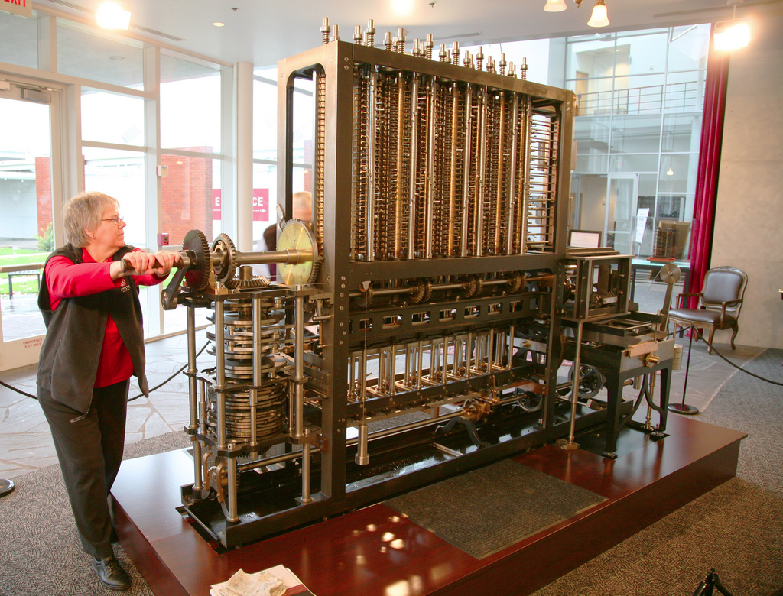
Charles Babbage's Difference Engine No. 2 •simpler than his Analytical Engine •8,000 parts •5 tons •11 feet long
Notes:
https://www.techrepublic.com/pictures/babbages-difference-engine-and-other-historic-computers/
http://www.computerhistory.org/babbage/
Charles Babbage (1791-1871), considered computer pioneer, designed the first automatic computing engines but they were too complex to build. The first complete Babbage Engine was completed in London in 2002, 153 years after it was designed.
Difference Engine No. 2, a calculator, built faithfully to the original drawings, consists of 8,000 parts, weighs five tons, and measures 11 feet long.
Babbage's more complex Analytical Engine has never been built.
Note that the difference engine used base 10.

Slide 15
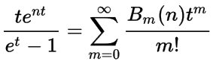
Short history of Programming Languages
First computer program, a “diagram of development”, was written by Ada Lovelace in 1842 calculating Bernoulli numbers on Charles Babbage’s Analytical Engine.
See Note G in "Sketch of The Analytical Engine, with notes upon the Memoir by the Translator". Switzerland
Notes:
Charles Babbage had the idea of building a mechanical computer to automate the process of creating the mathematical tables used in navigation. Calculation and transcription errors in such tables could be fatal, causing ships to be lost.
Augusta Ada Lovelace, a mathematician, worked with Charles Babbage to create a description of Babbage's unbuilt invention, the analytical engine, a highly advanced mechanical calculator often considered a forerunner of the electronic calculating computers of the 20th century. Ada Lovelace's "notes," describing the analytical engine, published in Taylor's scientific memoirs in 1843, contained a ground-breaking description of the possibilities of programming the machine to go beyond number-crunching to "computing" in the wider sense in which we understand the term today. https://ieeexplore.ieee.org/document/1253887
She foresaw that a machine like the Analytical Engine wasn’t just limited to numbers and could in fact act on any objects “whose mutual fundamental relations could be expressed by those of the abstract science of operations, and which should be also susceptible of adaptations to the action of the operating notation and mechanism of the engine.” (quote from her notes)
https://twobithistory.org/2018/08/18/ada-lovelace-note-g.html (a lot of math is discussed but you can skip those parts if you are not a mathematician like Ada)
Calculating Ada: The Countess of Computing https://www.bbc.co.uk/programmes/p030s5bx

Slide 16
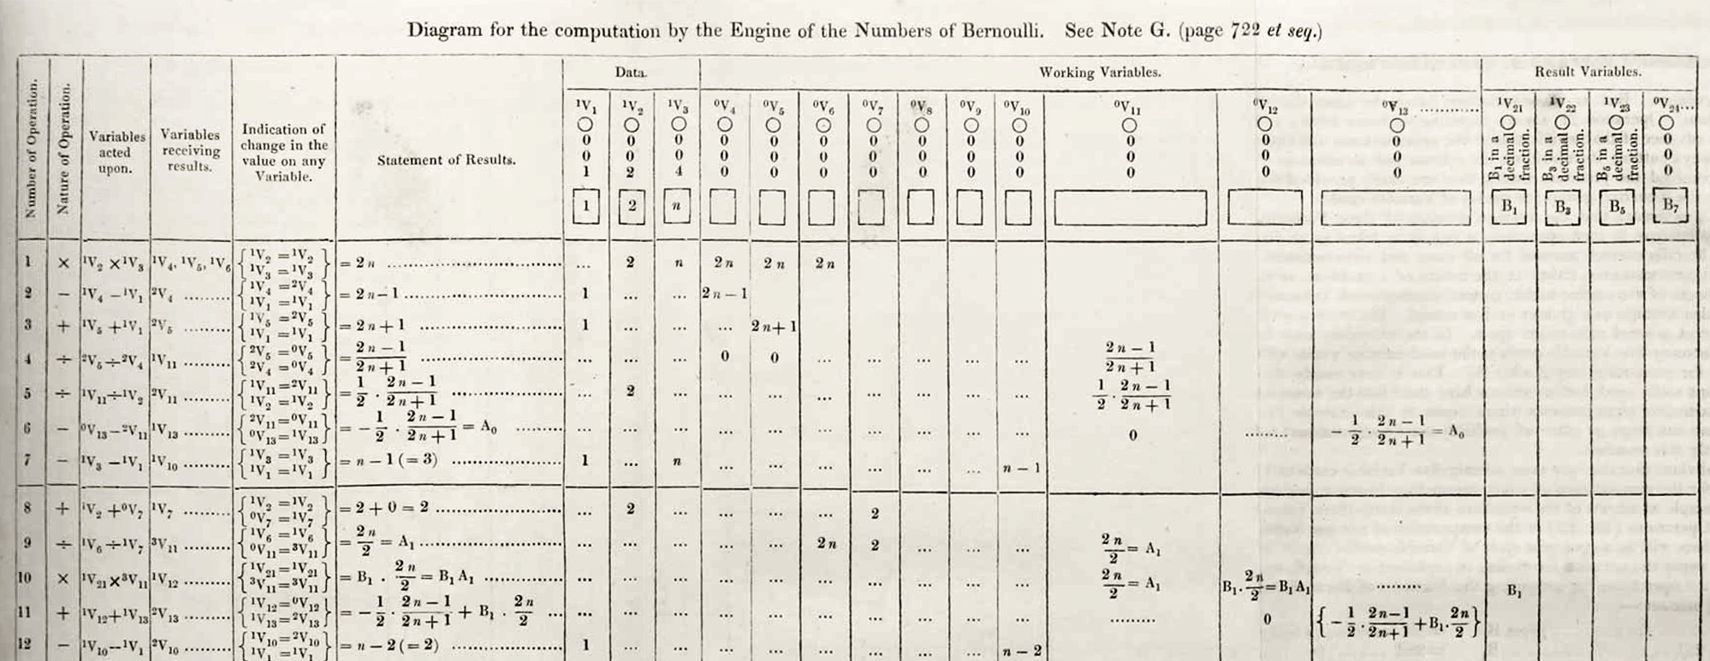
The first program
Number of Operation | Nature of Operation | Variables acted upon | Variables receiving results | Indication of change on the value on any Variable | Statement of Results | Data | Working Variables | Result Variables
Notes:
https://en.wikipedia.org/wiki/Ada_Lovelace#/media/File:Diagram_for_the_computation_of_Bernoulli_numbers.jpg
Column titles shown in highlighted row. Sounds like elements of a program, doesn’t it?
C language equivalent
https://gist.github.com/sinclairtarget/ad18ac65d277e453da5f479d6ccfc20e
Python language equivalent
https://enigmaticcode.wordpress.com/tag/bernoulli-numbers/

Slide 17
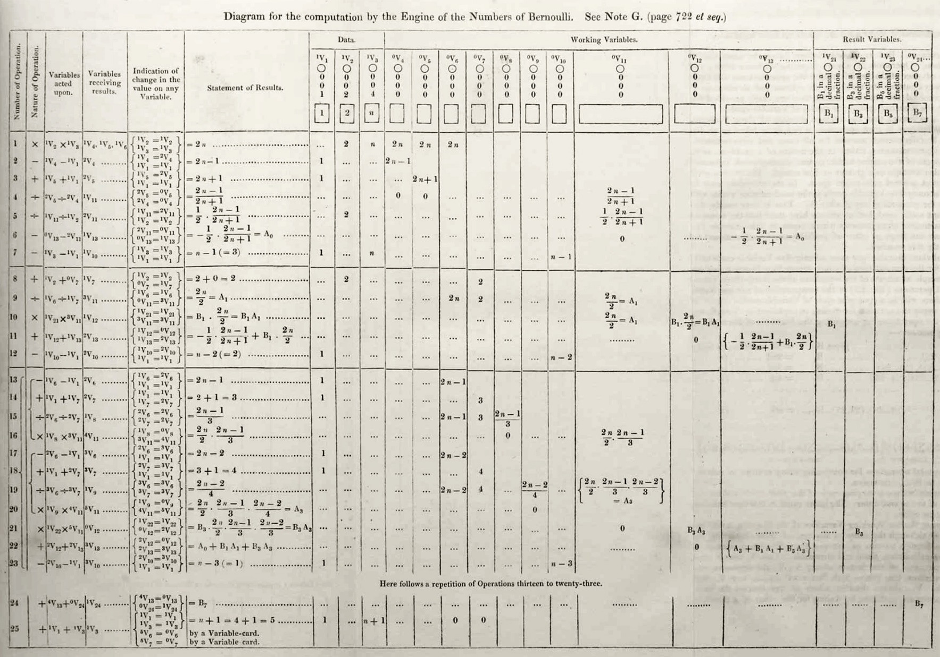
Number of Operation: Sequential Logic put on socks then shoes
Indication of change in value: Conditional Logic IF weather = cold THEN wear boots
Here follows a repetition of Operations 13 – 25: Iteration Logic FOR EACH side (Left, Right) put foot into shoe
Notes:
Control Structures (Böhm-Jacopini theorem, 1966)
There are three kinds of programming logic: Sequence, Selection, and Iteration.
Sequence: It is best to put your socks on before your shoes.
Selection (Conditional): the weather determines the type of footwear
Iteration: For each of Left & Right, put foot into shoe…hoping the left foot goes into the left shoe.
Sequential logic
"Life is just one damn thing after another." -- Mark Twain
do this, and then do that, and then do …
Conditional (Selection or Decision) logic
"Damned if you do, damned if you don't" -- Lorenzo Dow
Either do this OR do that.
Iterative (Looping or Repeating) logic
"It is not true that life is one damn thing after another. It's one damn thing over and over." -- Edna St. Vincent Millay
Endless Loop: n., see Loop, Endless. Recursion. See: Recursion
Loop, Endless: n., see Endless Loop.
How do programmers ever get out of the shower?
Shampoo bottle instructions: Lather, Rinse, Repeat.

Slide 18
With logic, comes bugs.
The operators of the Mark II Aiken Relay Calculator noted they had found a real bug.
Grace Hopper observed that they had “debugged” the machine.
Notes:
https://blog.patracompany.com/the-history-of-the-computer-bug
https://en.wikipedia.org/wiki/Debugging
Note in logbook of a Grace Hopper project:
“Moth found trapped between points at Relay # 70, Panel F, of the Mark II Aiken Relay Calculator while it was being tested at Harvard University, 9 September 1947. The operators affixed the moth to the computer log, with the entry: “First actual case of bug being found”. They put out the word that they had “debugged” the machine. In 1988, the log, with the moth still taped by the entry, was in the Naval Surface Warfare Center Computer Museum at Dahlgren, Virginia. Image ©Courtesy of the Naval Surface Warfare Center, Dahlgren, VA., 1988. NHHC Collection
“The OED Supplement records sense (4b) of the noun bug (“a defect or fault in a machine, plan, or the like”) as early as 1889. In that year the Pall Mall Gazette reported (11 Mar: 1) that ‘Mr. Edison … had been up the two previous nights discovering a ‘bug’ in his phonograph–an expression for solving a difficulty, and implying that some imaginary insect has secreted itself inside and is causing all the trouble.’….
This meaning was common enough by 1934 to be recognized in Webster’s New International Dictionary: ‘bug, n…. 3. A defect in apparatus or its operation… Slang, U.S.’”
So, the “actual bug” notation in the lab notebook above probably reflects the amusement of the technician at finding a physical bug, when the word bug was already in use as slang for a problem.
The term “debugging” came into use around Hopper’s time period; Hopper has said she did not coin the term but, given her status in the IT world, she no doubt had much to do with the term catching on.

Slide 19
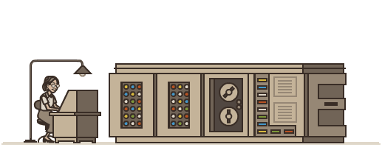
With logic, comes bugs.
The operators of the Mark II Aiken Relay Calculator noted they had found a real bug.
Grace Hopper observed that they had “debugged” the machine.
Google Doodle on Grace Hopper's 107th birthday
Notes:
https://www.wired.com/2013/12/googles-doodle-honors-grace-hopper-and-entomology/
https://www.google.com/doodles/grace-hoppers-107th-birthday
To replay animation during slide show, backup to previous slide and go forward again

Slide 20
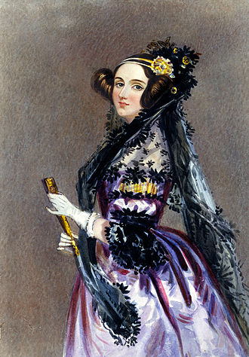
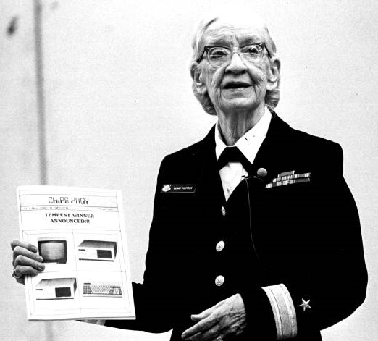
Ada Lovelace Grace Hopper 1815 – 1852 1906 -- 1992
Computing Pioneers
The mothers of programming
Notes:
Grace Hopper was described as appearing to be "'all Navy', but when you reach inside, you find a 'Pirate' dying to be released". (Jay Elliot )
For example, "Humans are allergic to change. They love to say, "We've always done it this way." I try to fight that. That's why I have a clock on my wall that runs counterclockwise." — Grace Hopper
"I had a running compiler [in 1952], and nobody would touch it because, they carefully told me, computers could only do arithmetic; they could not do programs. It was a selling job to get people to try it. I think with any new idea, because people are allergic to change, you have to get out and sell the idea."
https://history-computer.com/ModernComputer/Software/FirstCompiler.html
"It’s much easier for most people to write an English statement than it is to use symbols. So I decided data processors [programmers] ought to be able to write their programs in English, and the computers would translate them into machine code. [She invented the first compilers and machine-independent programming languages in 1952 – 1954] That was the beginning of COBOL, a computer language for data processors. I could say “Subtract income tax from pay” instead of trying to write that in octal code or using all kinds of symbols. "
"The most important thing I've accomplished, other than building the compiler, is training young people. They come to me, you know, and say, 'Do you think we can do this?' I say, "Try it." And I back 'em up. They need that. I keep track of them as they get older and I stir 'em up at intervals so they don't forget to take chances."
We should all be Grace Hoppers.
https://en.wikipedia.org/wiki/Grace_Hopper
https://en.wikipedia.org/wiki/List_of_pioneers_in_computer_science
https://www.dailymotion.com/video/x35dsz7 Letterman interview (very entertaining)
https://www.youtube.com/watch?v=wgTFi2vINV4(60 minutes interview)
https://ghc.anitab.org/
Commodore Grace Hopper speaking at the Miami-Dade Community College North Campus. 1984. Black & white photoprint. State Archives of Florida, Florida Memory. Accessed 21 Sep. 2019.<https://www.floridamemory.com/items/show/15354>.

Slide 21
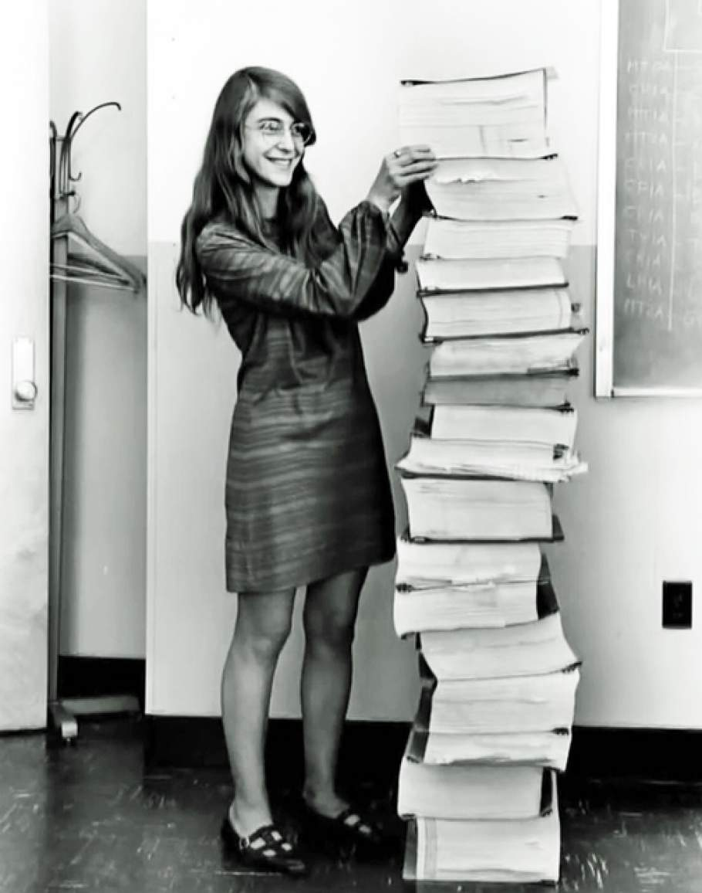
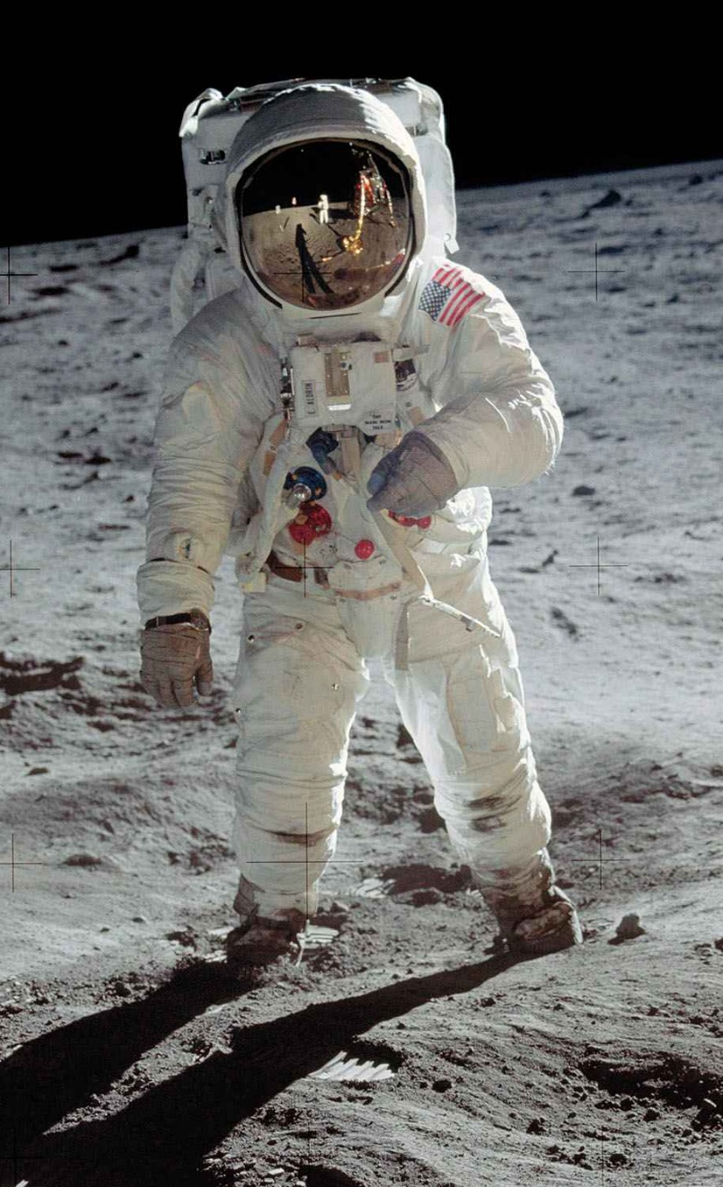
The First Software Engineer
Margaret Hamilton
lead software engineer on Project Apollo 1965 – 1972
Designed Apollo Guidance Computer to run tasks by real-time priority instead of expected sequence.
Hamilton with all the AGC program listings. She is 5'6" 168cm tall.
Notes:
NASA and the US gov't would not allow women to be astronauts despite being at least equally capable, but a women got astronauts to the moon.
(see the Netflix documentary "Mercury 13" https://www.netflix.com/watch/80174436 )
https://www.youtube.com/results?search_query=margaret+hamilton+software
Margaret Hamilton, renowned mathematician and computer science pioneer, is credited with coining the term software engineering while developing the guidance and navigation system for the Apollo spacecraft as head of the Software Engineering Division of the MIT Instrumentation Laboratory which developed the hardware and software for the Apollo program's computer. That was the world's first portable computer, and the moon's.
"In this picture, I am standing next to listings of the actual Apollo Guidance Computer (AGC) source code," Hamilton says. ("To clarify, there are no other kinds of printouts, like debugging printouts, or logs, or what have you, in the picture." ) “The space mission software had to be man-rated [safe for humans to use]. Not only did it have to work, it had to work the first time. Not only did the software itself have to be ultra-reliable, it needed to be able to perform error detection and recovery in real time. Our languages (Assembly) dared us to make the most subtle of errors. We were on our own to come up with rules for building software. What we learned from the errors was full of surprises.” It is acknowledged that there were no bugs in the software she and her team created – due to good software engineering: thoughtful design, careful implementation, thorough testing.
see https://en.wikipedia.org/wiki/Human-rating_certification
Margaret Hamilton argued to include input validation because her daughter crashed the AGC while playing with the keyboard. (Margaret often brought her child to the lab.) The AGC was a very limited system (72K ROM + 4K RAM ); deciding what was included and not included was a result of careful design decisions within the constraints imposed by the first computer to run off-planet. She was told "astronauts do not make mistakes", they were "trained to be perfect". During the Apollo 8 approach to the moon, Jim Lovell made the same mistake as a 4 year old child; the computer crashed and lost its navigation data – collected in flight, stored in RAM – that would get Apollo 8 back to Earth from the moon. In 9 hours, Hamilton and her team figured out how to recreate the data and upload it from Earth to the AGC – not a use case anyone envisioned.
Three minutes before Neil Armstrong and Buzz Aldrin touched down on the moon, the Apollo lander alarms triggered with red and yellow warning lights across their console. It was the 1202 Program Alarm. The computer was overloaded with commands from the rendezvous radar while it was trying to run the landing system. The software overrode normal operations to let the astronauts know something was wrong. Fortunately, Hamilton had designed the system to prioritize tasks according to importance not sequence: to land the module on the surface of the moon. The software ran on a schedule and according to predefined procedure but also ran based on priority with measures in place to interrupt any program should something vital come up. The Apollo 11 mission could have been aborted or worse, but thanks to Margaret Hamilton's software design and her team's code to correct and recover from unexpected errors, three minutes later on July 20, 1969, Neil Armstrong said, "the Eagle has landed" with 30 seconds of fuel remaining.
https://www.discovermagazine.com/the-sciences/apollo-11s-1202-alarm-explained
AGC had a 15-bit wordlength + 1-bit parity, 2048 words RAM (magnetic-core memory), 36,864 words ROM (core rope memory) = 4K + 72K equivalent in 8-bit bytes.
https://en.wikipedia.org/wiki/Margaret_Hamilton_(software_engineer)
https://www.computer.org/publications/tech-news/events/what-to-know-about-the-scientist-who-invented-the-term-software-engineering
https://www.smithsonianmag.com/smithsonian-institution/margaret-hamilton-led-nasa-software-team-landed-astronauts-moon-180971575/
https://airandspace.si.edu/stories/editorial/rope-mother-margaret-hamilton
https://www.theguardian.com/technology/2019/jul/13/margaret-hamilton-computer-scientist-interview-software-apollo-missions-1969-moon-landing-nasa-women
https://www.wired.com/2015/10/margaret-hamilton-nasa-apollo/
https://medium.com/a-computer-of-ones-own/margaret-hamilton-coding-to-the-moon-6ba70b7e6b43
https://www.vox.com/2015/5/30/8689481/margaret-hamilton-apollo-software
https://www.computer.org/publications/tech-news/research/history-of-women-programmers-in-computing-gender
https://wehackthemoon.com/tech/apollo-onboard-flight-software
Google: Margaret Hamilton NASA Apollo

Slide 22
Short History of Programming Languages
Early Programming 1940s to 1960s focused on language structure, instruction sets, and inventing key elements like variables, sorting, binary trees, modular programs, subroutines, breakpoints / debugging, and compilers.
Thank: Ada Lovelace, ENIAC Six, Grace Hopper
FORTRAN (IBM, 1954) FORmula TRANslation
First widely used high-level general purpose programming language
LISP (John McCarthy, 1958), COBOL (Grace Hopper, 1959)
Both still in use for AI and business respectively
Notes:
Note that "many of the key elements we see today" were invented by Frances Holberton, Jean Bartik (two of the ENIAC Six), and Grace Hopper.
Any language that is old, was good enough to get old. All the others have been forgotten.
There are only two kinds of programming languages: those people always complain about and those nobody uses.
Shooting yourself in the foot with FORTRAN
After iterating through 5 digits and determining they are probabilistically toes and not fingers, FORTRAN shoots the related extremity…19 times out of 20.
LISP derives from "LISt Processor". Schema and other variants continue in the AI field.
You try to shoot yourself in the foot, but the gun jams when one of the many pairs of parenthesis was improperly nested.
e.g. (((You have ((plenty) of ((bullets))) ((but (lose))) (track of)) (the) ((silly ((gun)))(!))))
COmmon Business-Oriented Language – The first enterprise ready, business oriented programming language and still the most used language on mainframes. It was created by a committee which included some of the ENIAC-6 and was lead by Grace Hopper based on her FLOW-MATIC language which was the first to express operations using English-like statements, Hopper also created its compiler. The first implemented compiler was written by Grace Hopper, for one of her earlier languages. Grace also coined the term compiler.
In 1997, the Gartner Group reported that 80% of the world's business ran on COBOL with over 200 billion lines of code and 5 billion lines more being written annually.[97]
In 2006 and 2012, Computerworld surveys found that over 60% of organizations used COBOL (more than C++ and Visual Basic .NET) and that for half of those, COBOL was used for the majority of their internal software.
Shooting yourself in the foot with COBOL
SUBTRACT FOOT FROM LEG GIVING CRUTCH
https://www.veracode.com/blog/2013/04/the-history-of-programming-languages-infographic History of Programming Languages as of 2013
https://medium.com/commitlog/a-brief-totally-accurate-history-of-programming-languages-cd93ec806124

Slide 23
Short History of Programming Languages
1970s: structured programming { scope } instead of GOTO / TAG
C (Kernighan & Ritchie, 1978. The C Programming Language )
IF (true) IF (false) GOTO false3 { do this do this; GOTO bypass3 }
ELSE TAG false3 { do that
do that;
} TAG bypass3
FOR (i=0; i<n; i++) { do this n times }
i = 0
TAG loop7
IF (i => n) GOTO loop7end
do this
i = i + 1
GOTO loop7
TAG loop7end
Notes:
1970s: structured programming with subroutines, code blocks, and control patterns. GOTO was outlawed but it took until the 1980s to go away.
COBOL and C are examples of a Structured, Procedural programming paradigm
Machine Language:-
Binary code for operations that a particular computer hardware / CPU architecture can execute directly. Hard to write because humans are not machines.
Assembly language:- symbolic representation (a.k.a. mnemonics) of the machine code which executes the instructions of a particular CPU architecture; e.g. allows the programmer to name blocks of memory that hold data. Assembly language is designed to be easily translated into machine language by an Assembler. Assembly expects the programmer to know the rules; The Assembler translates from Assembly into machine language, it does not diagnose the quality and integrity of the code like a compiler does.
Compiler:- a program which translates a high level language's source code into machine language. A compiler enforces quality, integrity, and rules such as the use of data types and language syntax. COBOL is an example which is why it runs almost exclusively now on IBM mainframe and IBM I midrange platforms.
C was designed to be portable across CPU architectures. C source is translated to Assembly which is used by an Assembler to create machine code. Each platform's C compiler uses parameters to cross-reference generic instructions of the language to a specific CPU architecture's Assembly instructions. To port the compiler (port = modify a program to run on a different platform), the new CPU architecture's Assembly instructions are mapped to the compiler's generic instructions. This is a non-trivial exercise but is much easier and safer than creating a new compiler which outputs machine language directly from source code.
GOTO outlawed. As programs using GOTO grew with ongoing maintenance and enhancement, the code became unmaintainable, unreliable spaghetti code. Program flow is conceptually twisted and tangled like a bowl of spaghetti. https://en.wikipedia.org/wiki/Spaghetti_code
The GOTO is "an invitation to make a mess of one's program." Go To Statement Considered Harmful open letter in 1968 by Dutch computer scientist Edsger W. Dijkstra, who coined the term "structured programming". Dijkstra, E. W. (March 1968). "Letters to the editor: go to statement considered harmful". Communications of the ACM. 11 (3): 147–148.
C (Kernighan & Ritchie, 1978. The C Programming Language aka K&R)
The first cross platform systems programming language; created to rewrite and extend the UNIX OS beyond its original Assembler implementation.
https://www.toptal.com/c/after-all-these-years-the-world-is-still-powered-by-c-programming
Brian Kernighan: “Everyone knows that debugging is twice as hard as writing a program in the first place. So, if you we are as clever as you can be when you write it, how will you ever debug it?” https://en.wikiquote.org/wiki/Brian_Kernighan
Kernighan's remedy: comments
Shooting yourself in the foot with C You shoot yourself in the foot and no one, including you, can figure out how.
You have shot yourself in the foot; you run it again in debug mode while risking the other foot.
History of C by one of the people who invented the language
https://www.bell-labs.com/usr/dmr/www/chist.html
From https://www.cse.iitb.ac.in/grc/intdocs/gcc-conceptual-structure.html#Porting-GCC-for-Dunces-_0028by-Hans_002dPeter-Nilsson_0029
"Perhaps the most interesting part of the CGF is the code that is dependent on target properties, but has been “parameterized”. For instance, the target code generator of the compiler in operation needs to emit the target assembly code in the syntax of the target assembly language! Thus details like the layout structure of the assembly program must be known. Parameterization is a consequence of retargetability and the Compiler Generation Framework can then
name the various target properties in the main compiler code, and separately list out their target specific values for each target. "

Slide 24
Short History of Programming Languages
1980s: language standards, libraries, data I/O via databases.
From monolithic C and COBOL from PlayDoh to Object Oriented programming to Lego
C++ (Bjarne Stroustrup, 1985. The C++ Programming Language)
Relational Database Management Systems (RDBMS)
SQL (Structured Query Language: data storage & retrieval)
RDBMS & SQL developed at IBM in 1970s. In the late 80s, when servers became more powerful, DB & SQL replaced indexed files.
Notes:
C++ is a Structured, Object-Oriented programming paradigm
Object Orientation
Old programming models separated data and logic, fields in data files were defined and accessed directly by a program (no SQL, no Relational DBs with columns of data types and rows of data). Files existed separately from everything else. Any program could change a file according to it's own rules which were, hopefully, the same rules as in all the other programs.
1980s: Reduced Instruction Set Computing CPUs didn't do less, they did it more simply which improved compiler design and hardware/software performance.
C++ (Bjarne Stroustrup, 1985. The C++ Programming Language)
C with OO improvements allows high-complexity programming, e.g. operating systems, MS Word & Excel.
OOP can be used to associate real-world objects and processes
O-O Objects sometimes correspond to things found in the real world.
In OO, a class defines a thing that has it own state and behaviour. A class structure is hierarchical. As things become more and more specialized, they inherit from the class above and override behaviours and add to the attributes. Cars and Trucks both inherit from the Vehicles class. E.g. for biology, a class defining the commonalities of all plants, a class defining animals in general. The classes for Male and Female each inherit from the Species Sapiens which inherits from Genus Homo. Objects are instances of classes, e.g. the object michael represents a particular instance of the class Male. the object mary represents a particular instance of the class Female. Objects and know specific things about themselves like their names and can act upon what they know. Michael and mary know how to interact with each other according to their commonalities in the class Sapiens and their differences according to gender.
With classes, more of the high-level structure of your program is reflected in the code, not just in the comments.
This supported the move from monolithic programming like COBOL and C that did everything in one program to modular and Object Oriented programming …from carving a solid block of stone to building something up from Lego.
https://en.wikipedia.org/wiki/Object-oriented_programming
C++ makes it harder to shoot yourself in the foot than with C but, when you do, you blow your whole leg off. - Bjarne Stroustrup "be-AR-ne Strov-stroop"
Why do women like C more than C++? Because C doesn’t treat them like objects.
Women should not be seen as objects. Each woman is in a class of her own.
http://bigthink.com/videos/why-i-created-c ➔ Why I Created C++ by Bjarne Stroustrup
http://www.stroustrup.com/bs_faq.html
"Classes are there to help you organize your code and to reason about your programs. You could roughly equivalently say that classes are there to help you avoid making mistakes and to help you find bugs after you do make a mistake. In this way, classes significantly helps maintenance.
A class is the representation of an idea, a concept, in the code. An object of a class represents a particular example of the idea in the code. Without classes, a reader of the code would have to guess about the relationships among data items and functions - classes make such relationships explicit and "understood" by compilers. With classes, more of the high-level structure of your program is reflected in the code, not just in the comments.
Object Oriented means "programming using class hierarchies and virtual functions to allow manipulation of objects of a variety of types through well-defined interfaces and to allow a program to be extended incrementally through derivation. The point about arranging classes into a class hierarchy is to express hierarchical relationships among classes and use those relationships to simplify code." Even the explanations of C++ are hard to understand.
SQL (Structured Query Language: data storage & retrieval). SQL is a Declarative Programming paradigm: it specifies the desired result you want, not how to get it – the RDBMS knows about its internal storage.
In SQL, you DELETE your foot intentionally, then your phone starts ringing, and you hear everyone else's foot is also gone. NP, you can always ROLLBACK…but you were lazy and didn't set autoCOMMIT = OFF. Now where are today's backup tapes?
Data could now take care of itself without explicit programming
RDBMS and SQL set up and enforced the rules for data usage which all programs had to obey
SQL: SQL includes data query, data manipulation (insert, update and delete), data definition (schema creation and modification), and data access control.
https://en.wikipedia.org/wiki/SQL https://en.wikipedia.org/wiki/Stored_procedure
“The increasing adoption of stored procedures led to the introduction of procedural elements to the SQL language in the SQL:1999 and SQL:2003 standards in the part SQL/PSM. That made SQL an imperative programming language. Most database systems offer proprietary and vendor-specific extensions, exceeding SQL/PSM. A standard specification for Java stored procedures exists as well as SQL/JRT.”
https://msdn.microsoft.com/en-us/library/ms178642.aspx
https://www.ibm.com/support/knowledgecenter/beta/SSEPEK_10.0.0/apsg/src/tpc/db2z_storedprocedure.html
`https://en.wikipedia.org/wiki/History_of_programming_languages
https://en.wikipedia.org/wiki/Structured_programming

Slide 25
Short History of Programming Languages (Cont’d)
1990s: GUIs & event-driven programming, the rise of the Internet
object-orientation tries to become the new normal
Visual Basic (1991) – OOPish with UI objects, GUI layout tools
VB is derided among 'real' programmers but the following languages are near the top of most popularity indexes along with C, C++, and C#.
Python (1991) – readable, open sourced, scalable, extensible
Java (1995) – "write once, run anywhere" with bytecode & JVM
Interpreted / scripting languages for flexibility
JavaScript (1995) – runs in browser and in Node.js server side
PHP (1995) PHP: Hypertext Preprocessor (recursive acronym)
Notes:
"Event-handling is necessitated by the way human-computer interaction works — you’re talking to the analog world, it’s not going to be pretty. The user will do something, it’s generally unrelated to what, if anything, your code was doing. You need to deal with it." Tonio Loewald http://loewald.com/blog/
GUI programming requires an Event-Driven paradigm: UI emitters and program listeners of asynchronous actions which activates modular code.
Buttons have their own Click event so the programmer does not have to listen and interpret atomic mouse events.
The MouseClick event will trigger only when the left mouse button is pressed and released on the same object within a short length of time. Detecting whether two click events are really one MouseDoubleClick event can be trickier. onMouseDown and onMouseUP events occur if the time between them is GT single click time (determined by settings in the OS); a difference in mouse down and mouse up coordinates can indicate drag-and-drop of an object or click-and-drag selection or just a very slow click.
For further info, see this first: https://javascript.info/mouse-events-basics https://www.w3schools.com/jsref/obj_mouseevent.asp
https://en.wikipedia.org/wiki/Observer_pattern https://docs.microsoft.com/en-us/dotnet/standard/events/observer-design-pattern https://docs.microsoft.com/en-us/dotnet/standard/events/index?view=netframework-4.8 https://docs.microsoft.com/en-us/dotnet/api/system.windows.forms.control.mouseclick?view=netframework-4.8
https://docs.microsoft.com/en-us/dotnet/framework/winforms/how-to-distinguish-between-clicks-and-double-clicks
https://www.google.com/search?q=event+programming+for+mouse+click
Every time Microsoft released a new version of Visual Basic, it had the same problem: they broke old code by changing commands and structures. Google a question about VB command/syntax and you will get many answers only one of which will work in your version of VB.
Visual Basic
You draw yourself being shot in the foot with a water pistol.
You do a Google search on how to shoot yourself in the foot using Visual Basic. There are seventeen completely different ways to do it only one of which will compile in your VB's version. Finally, it does some of what you want and some of what it wants.
Microsoft was good at making easy problems easy to solve – that got you hooked. But hard problems were impossible.
Python – "batteries included" describes the standard library, which covers everything from asynchronous processing to zip files.
The language's core philosophy is summarized in the document The Zen of Python (PEP 20), which includes aphorisms such as:[53]
Beautiful is better than ugly
Explicit is better than implicit
Simple is better than complex
Complex is better than complicated
Readability counts
You shoot yourself in the foot but it was much more elegantly done in Python than C or, God forbid, Perl.
You insert the bullet into the gun but it was a single TAB bullet instead of 4 blanks and the gun jams with an Indent Error.
You try to shoot yourself in the foot but you just keep hitting the whitespace between your toes.
Java
In 1990, Dr. Jim Gosling, a Canadian from Calgary, and two other programmers at Sun Microsystems, were given carte blanche and a million dollars (in the first year, about $2M today) to do something to unify all the various devices exploding into the market with embedded computer chips, everything from toasters to doorknobs in hotels, to home entertainment systems that needed a bag full of remote controllers to work the stuff. The electronics world was becoming ridiculously complex. Everyone was reinventing their own wheel. "With a little computer science, all of these things could be made to work together,'' Gosling insisted. So Gosling , Naughton, and Mike Sheridan set out to create something that would program all manner of different computing devices from servers to toasters and do it over a network. C and C++ were not up to that task so Java was invented.
https://www.wired.com/1995/12/java-saga/
Gosling was the leading architect and creator of Java and the idea for the Java Virtual Machine. He had been working on those concepts, on and off, for much of his life.
C/C++-style syntax aided adoption, made C++ ideas practical and Object Orientation portable across platforms. Most stock-exchange systems are written in Java because Java is good for hard problems that need complex parallel processing. It made OOP safer and more practical for high level applications.
With Java, you can shoot yourself in the foot on any gun platform.
"I had a problem so I decided to use Java. … Now I have a ProblemFactory."
Java is now mostly server side. Java is the official language for Android development.
Bjarne Stroustrup said he would have done things Java does automatically with memory management that must be done in C++ explicitly (known as garbage collection) if computers had been as powerful 10 years earlier.
If you shoot yourself in the foot with Java, you are not worried because it was only a reference to your foot. Shortly thereafter, automatic garbage collection amputates your foot.
https://www.theglobeandmail.com/news/national/canada-150/canadas-code-guru-an-international-star/article35280585/
Interpreter:-
An interpreter is a program which translates statements of a program into machine code. It translates only one statement of the program at a time. It reads only one statement of program, translates it and executes it. Then it reads the next statement of the program again translates it and executes it. In this way it proceeds further till all the statements are translated and executed.
JavaScript drove everyone crazy for the first 10 years of its life because its implementation was not standardized in browsers. What worked in Microsoft’s I.E. did not work in Netscape, etc.
What's the difference between JavaScript and Java?
One is essentially a toy, designed for writing small pieces of code, and traditionally used and abused by inexperienced programmers.
The other is a scripting language for web browsers. ;-)
JavaScript may have got its name as a co-marketing deal between Netscape and Sun, in exchange for Netscape bundling Sun's Java runtime with their then-dominant browser. See https://en.wikipedia.org/wiki/JavaScript#History
Now, with standardization (ECMAScript, 5th Edition in 2008 was the first reliable version, now in 10th Edition - ECMAScript 2019), JavaScript is a key tool of web development on both client and server sides. The Node.js server side support for JS was written mostly in C++, an area C++ is good at.
JavaScript You've perfected a robust, rich user experience for shooting yourself in the foot. You then find that bullets are disabled on your gun.
To shoot your foot, you need a shoe with a dozen .js libraries, frameworks, and plugins all working together so the browser can fire the gun.
PHP PHP: Hypertext Preprocessor (recursive acronym)
popular web server side scripting language interfaces with DB to create dynamic web sites
You try to shoot yourself in the foot with a gun made with pieces from 300 other guns. If the HTTP connection doesn't time out, your foot is shot. Do not reload this page or use the back button: the shooting page is no longer reachable.
http://web.eecs.utk.edu/~huangj/CS302S04/notes/oo-intro.html
PHP (recursive acronym for PHP: Hypertext Preprocessor)
http://statisticstimes.com/tech/top-computer-languages.php

Slide 26
Short History of Programming Languages (Cont’d)
2000s: Object Oriented Programming is now mainstream
C# (Microsoft, 2001) Inherits from Java and C++
.NET Core is open-source, general-purpose, cross platform
Windows PowerShell (2006), PowerShell Core (2016) for scripting
Object based command line and scripting language.
Core is cross platform for Windows, Linux, Mac, and ARM
2010+: mobile and tablets (Android=Java), non-SQL DB, security by design (Rust), parallel programming (GPUs), big data (Hadoop + Java / Python), distributed processing (e.g. blockchain), quantum computing (IBM & Google)
See TIOBE, PYPL for language popularity; see this for efficiency
Notes:
What is the object oriented way to become wealthy? Inheritance. (It will be funnier next term in C++ classes together with polymorphism and encapsulation.)
C#
You shoot yourself in the foot but have only yourself to blame for using the unsafe keyword.
PowerShell You Get-Foot and wonder if you should pipe it to bullet or call Set-Bullet -foot; either way, you get back an object with hundreds of attributes and can't find the bullet wound in any of them.
Get-Targets | Select-Object foot | Fire-Weapon -safety off | Export-Bullet
https://docs.microsoft.com/en-us/powershell/scripting/overview?view=powershell-6
https://blogs.msdn.microsoft.com/powershell/
https://www.geeksforgeeks.org/difference-between-sql-and-nosql/
Both Concurrent and Parallel programming have different, independent execution paths, known as threads or modules, that (appear to) run at the same time.
Concurrent execution is possible on single processor (multiple threads, managed by scheduler, run asynchronously)
Parallel execution runs multiple threads simultaneously on multiple processors. (One thread per many CPU/GPU processors)
Concurrent execution is the generalized form of parallel execution. Parallel programs are concurrent but concurrent programs are not necessarily parallel.
Concurrency means that two or more calculations happen within the same time frame, and there is usually some sort of dependency between them.
Parallelism means that two or more calculations happen simultaneously.
Put boldly, concurrency describes a problem (two things need to happen together), while parallelism describes a solution (two processor cores are used to execute two things simultaneously).
Distributed programs = programs working together on multiple, separate systems
Quantum computing
https://quantumexperience.ng.bluemix.net/qx/experience ⬅ Explore IBM Q quantum computing
https://www.research.ibm.com/ibm-q/
https://stuff.co.za/ibm-launches-commercial-quantum-computing-were-not-ready-for-what-comes-next/
https://en.wikipedia.org/wiki/Measuring_programming_language_popularity
Energy Efficiency across Programming Languages
http://greenlab.di.uminho.pt/wp-content/uploads/2017/09/paperSLE.pdf
C is fast, lite, and efficient. Python is a pig.

Slide 27
Programming Architectures
Interpreted vs Hybrid vs Compiled
High vs Low level
General purpose vs domain-specific
Bad code can be written in any language
Read the following slides before doing today's activity and next week's quiz.
Notes:
See https://cs.lmu.edu/~ray/notes/paradigms/

Slide 28
Programming Architectures
Platform = Operating System (OS) + hardware | Interpreted | Hybrid | Compiled
High level, Domain-Specific Languages execute inside a host application or OS dynamically typed Scripting interpreted at run-time, not compiled | Command Line Interpreter: OS cmds, Unix shell scripts, MS PowerShell Browser: JavaScript Web Server: PHP RDBMS: SQL MS Office: VBApp
High level, General Purpose Languages execute on the OS dynamically or strongly typed Interpreted & Hybrid need run-time enviro | Python, Groovy (Java), BASIC | Java Python .NET C#, VB | C C++ COBOL
Low level, General Purpose Languages run 'on the bare metal' strongly typed used to create OS, device drivers, compilers, virtual machines (Hybrid run-time enviros) |  |  | C C++
Notes:
You know that HTML, CSS, XML are not programming languages, they are markup languages. But don’t criticize your User Interface designer if they say they program in HTML. You need that designer to help you create a good UX – User eXperience.
Platform = OS + hardware
Interpreted Languages like Python, Javascript, do not require compilation before being run. Although interpretation is slow, virtually all have local OS runtime optimizations to improve performance. Interpreted languages are "dynamically typed" which means that variables and values are classified into types (alpha or numeric) during run time. This is part of their flexibility.
Any interpreted language or set of commands run inside an environment that knows how to run the code. For example, a Command Language Interpreter (CLI) is an environment like MS PowerShell or *nix Bash shell which get their instructions from a CLI (command line interface) and/or stored script files. Used for system and job task automation. These types of things must be interpreted because they depend on the current state of a platform which is dynamic and its state is always changing.
Hybrid Languages: first compiled into platform-neutral bytecode and then interpreted by a virtual machine for the local platform. E.g. Java, C#, and Python. Very portable.
If your application needs more control over the platform and/or performance, you need a Compiled language.
Compiled Languages: translators generate machine specific instructions from source code. E.g. C, C++, and Objective-C are compiled. Fast but maintenance of programming packages (many programs working together) is less flexible than with interpreted languages. Variables statically typed: data types declared by programmer. the compiler will catch data type errors. with interpreted code, the user catches the error.
High-Level: run on top of the OS (using Low-Level services) allowing programming to be independent of the "bare metal". C & C++ programs using OS services such as input/output/files, run at a High-Level.
Low-Level: runs directly on the hardware, the "bare metal".
Assembly, C, C++ running directly on x86 architecture or other chips.
Operating Systems are written in these languages creating Low-Level services for High-Level programs.
Domain Specific Languages are languages created to support a particular set of tasks within a problem/solution domain. Domain-Specific Languages are executed within an application; they are similar but less 'General Purpose' than Interpreted languages. (Domain-Specific Languages have also been called Embedded Languages; today, the term 'embedded' often refers to embedded systems such as IoT devices.) Web servers process script commands (e.g. PHP or JavasScript) which are literally 'embedded' in a dynamic HTML file before generated HTML is sent to client (browser). VBA (Visual Basic for Applications) is run inside MS Office apps. JavaScript used to be run only in the browser from JS cmds inside the HTML, i.e. 'embedded' but JS has become quite powerful on its own with packages like Node.js, Angular, and others for web applications running on both servers and clients so, today, JS is more properly thought of as an interpreted, general purpose language.
SQL is a domain specific language to define, query, manipulate, and control a database. SQL is a declarative language in which you tell the computer what to do, not how. E.g. create a Table with these Columns… The DB itself has its own interpreter that runs the SQL instructions inside the DB. SQL is not exactly a general purpose language but does have the sequential, iterative, decision logic abilities of high level languages.
A long read…
https://www.bloomberg.com/graphics/2015-paul-ford-what-is-code/

Slide 29
Short history of Programming Languages (read L8R)
1970s: structured programming with subroutines, code blocks, and control patterns. GOTO was outlawed but it took until the 1980s to go away.
C (Kernighan & Ritchie, 1978. The C Programming Language aka K&R)
The first cross platform systems programming language; created to rewrite UNIX.
1980s: standards, consolidation, modules, performance, RDBMS.
From monolithic C and COBOL to modular and Object Oriented programming
C++ (Bjarne Stroustrup, "be-AR-ne Strov-stroop" 1985. The C++ Programming Language)
C with OO improved Systems Programming (OS) & high-performance applications.
Classes unified data & logic into objects that have their own state and behaviour. Objects know things about themselves and can act upon what they know.
Relational Database Management Systems (RDBMS)
SQL (Structured Query Language: data storage & retrieval)
Data could now take care of itself without explicit programming
RDBMS and SQL set up and enforced the rules for data usage which all programs had to obey
Notes:
https://en.wikipedia.org/wiki/History_of_programming_languages
https://en.wikipedia.org/wiki/Structured_programming
GOTO outlawed. As programs using GOTO grew with ongoing maintenance and enhancement, the code became unmaintainable, unreliable spaghetti code. Program flow is conceptually twisted and tangled like a bowl of spaghetti. https://en.wikipedia.org/wiki/Spaghetti_code
The GOTO is "an invitation to make a mess of one's program." Go To Statement Considered Harmful open letter in 1968 by Dutch computer scientist Edsger W. Dijkstra, who coined the term "structured programming". Dijkstra, E. W. (March 1968). "Letters to the editor: go to statement considered harmful". Communications of the ACM. 11 (3): 147–148.
1980s: Reduced Instruction Set Computing CPUs didn't do less, they did it more simply which improved compiler design and hardware/software performance.
This supported the move from monolithic programming like COBOL and C that did everything in one program to modular and Object Oriented programming …from carving a solid block of stone to building something up from Lego.
Old programming models separated data and logic, fields in data files were defined and accessed directly by a program (no SQL, no Relational DBs with columns of data types and rows of data).
Files existed separately from everything else. Any program could change a file according to it's own rules which were, hopefully, the same rules as in all the other programs.
https://en.wikipedia.org/wiki/Object-oriented_programming
OOP can be used to associate real-world objects and processes
O-O Objects sometimes correspond to things found in the real world.
C++: an octopus made by nailing extra legs onto a dog. – Steve Taylor
C++ makes it harder to shoot yourself in the foot than with C but, when you do, you blow your whole leg off. - Bjarne Stroustrup
http://bigthink.com/videos/why-i-created-c ➔ Why I Created C++ by Bjarne Stroustrup
http://www.stroustrup.com/bs_faq.html
"Classes are there to help you organize your code and to reason about your programs. You could roughly equivalently say that classes are there to help you avoid making mistakes and to help you find bugs after you do make a mistake. In this way, classes significantly helps maintenance.
A class is the representation of an idea, a concept, in the code. An object of a class represents a particular example of the idea in the code. Without classes, a reader of the code would have to guess about the relationships among data items and functions - classes make such relationships explicit and "understood" by compilers. With classes, more of the high-level structure of your program is reflected in the code, not just in the comments.
Why is it that women find C to be more attractive than C++? Because C doesn’t treat them like objects.
Women should not be seen as objects. Each woman is in a class of her own.
Object Oriented means "programming using class hierarchies and virtual functions to allow manipulation of objects of a variety of types through well-defined interfaces and to allow a program to be extended incrementally through derivation. The point about arranging classes into a class hierarchy is to express hierarchical relationships among classes and use those relationships to simplify code." Even the explanations of C++ are hard to understand.
SQL
You delete your foot intentionally and find out later that everyone else's foot is also gone.
Your foot is deleted but you can always ROLLBACK and undelete it…oops! you were lazy and left automatic commit ON.
SQL: SQL includes data query, data manipulation (insert, update and delete), data definition (schema creation and modification), and data access control.
https://en.wikipedia.org/wiki/SQL https://en.wikipedia.org/wiki/Stored_procedure
“The increasing adoption of stored procedures led to the introduction of procedural elements to the SQL language in the SQL:1999 and SQL:2003 standards in the part SQL/PSM. That made SQL an imperative programming language. Most database systems offer proprietary and vendor-specific extensions, exceeding SQL/PSM. A standard specification for Java stored procedures exists as well as SQL/JRT.”
https://msdn.microsoft.com/en-us/library/ms178642.aspx
https://www.ibm.com/support/knowledgecenter/beta/SSEPEK_10.0.0/apsg/src/tpc/db2z_storedprocedure.html
`

Slide 30
High vs Low Level Programming Languages
Platform = OS + hardware
Low-Level: runs directly on the hardware, the "bare metal".
operating systems and device drivers for specific hardware. e.g. Assembly, C, C++ running directly on x86 architecture, not the OS
High-Level: run on the OS using services of Low-Level code allowing programming to be independent of the "bare metal"
e.g. user-facing applications using OS services for I/O and files C & C++ for high performance games. Python for general purpose.
Audio/Visual Learning: Exploring Languages discusses this week's concepts and compares various languages.
Don't take the bait to click to the newer version, it will waste your time.
Notes:
C++ Instructor: “Those darn students keep asking us to teach more low-level languages.” C Instructor: “So?” C++ Instructor: “So… if I told them once, I’ve told them a thousand times: There are no classes in C”
https://en.wikipedia.org/wiki/Computing_platform
The term "low-level" may seem a bit disparaging, but -- in computer science -- it actually refers to a programming language that provides little or no abstraction from a computer's underlying hardware architecture. Low-level languages use the CPU's instruction set.
By comparison, Python is often said to be a high-level language, which means that it is abstracted from the nitty-gritty details of the underlying system. High-level languages use an abstract instruction set. Python and Java use a virtual machine's instruction set. The VM translates those to CPU specific instructions. Earlier high-level languages such as C and COBOL had compilers which could take the same source code and compile on different platforms. Students do it now by compiling for a PC platform using Visual Studio and for a Linux platform using gcc compiler.
(https://www.embedded.com/electronics-blogs/max-unleashed-and-unfettered/4441623/Python-is-better-than-C---Or-is-it-the-other-way-round-)
Seneca students, faculty, and staff must first register to use LinkedIn Learning (formerly Lynda.com) by creating a separate LinkedIn Learning account through the "LOG IN TO LinkedIn Learning" link on the website http://inside.senecacollege.ca/mylearning more info at https://seneca.libanswers.com/faq/195592
http://library.senecacollege.ca/Find_Articles/Purls/LinkedInLearning_PURL.pdf

Slide 31
Types of Programming Languages
Interpreted/Scripting Languages: line-by-line execution of source code. Not compiled. Little pre-runtime translation. Slower but flexible and reactive. Variables dynamically typed at run time.
Domain-Specific Languages exist inside an application.
Web servers process script commands (PHP) embedded in a dynamic HTML file before generated HTML is sent to client (browser). JavaScript is run in the browser from JS cmds inside the HTML. VBA (Visual Basic for Applications) is run inside MS Office apps.
Command Language Interpreter (CLI) (or a shell that runs scripts) MS-PowerShell, *nix Bash, IBM z Job Control Language, IBM i Control Language
Data-Oriented Languages (like SQL) designed for management of data in relational databases. SQL with its stored procedures is not a general purpose programming language; SQL is RDBMS specific.
Notes:
Interpreted Languages do not require compilation before being run. Some OS have local optimizations to improve performance especially for JavaScript.
interpreted languages are "dynamically typed" which means that variables and values are classified into types (alpha or numeric) at run time. This is part of their flexibility.
In depth discussion at https://stackoverflow.com/questions/2998215/if-python-is-interpreted-what-are-pyc-files
Command Language Interpreter (CLI) is often confounded with CLI (command line interface). The latter is just a text-based terminal prompt >
if you’re serious about being a sysadmin, you don’t spend your day clicking things in a GUI, you run your network from a command line.
Used for system and job task automation.
SQL is a domain specific language, that being databases. SQL is a declarative languages in which you tell the computer what to do, not how. E.g. create a Table with these Columns… The DB itself has its own internal code that determines exactly how it is done.
<!DOCTYPE HTML>
<html>
<head>
<title>Domain-specific scripting examples</title>
</head>
<body>
<!–– PHP script in an HTML file ––>
<?php
echo "Hi, I'm a PHP script!";
?>
<!–– JavaScript in an HTML file ––>
<script>
alert( 'Hello, world!' );
</script>
</body>
</html>

Slide 32
Types of Programming Languages
Compiled Languages: translators generate machine specific instructions from source code. E.g. C, C++, and Objective-C are compiled. Fast but less flexible than interpreted languages. Variables statically typed: data types declared by programmer.
Hybrid Languages: first compiled into platform-neutral bytecode and then interpreted by a virtual machine for the local platform. E.g. Java, C#, and Python.
Notes:
Java: Write Once, Run Anywhere. The Bytecode is generic Java. The JVM – Java Virtual Machine – is unique to each platform (hardware & OS). The JVM reads generic bytecode and translates those instructions into platform specific machine code that executes. Numerous JVMs optimize the bytecode (e.g. Just-In-Time compilers) for performance near to compiled languages but much faster than interpreted languages.
Variables statically typed at compile time: It allows static (without running the program) detection of many programming errors quickly, reliably and automatically.
It prevents run-time errors such as “cannot concatenate string + numeric values”. It also increases speed of execution. The system never has to think, “Now what kind of value is in this variable and can it be used the way the program has specified?” Neither does the programmer have to remember—for sure—when writing the code; if the programmer forgets, the compiler will catch the error. In the case of a type error with interpreted code, the user catches the error.
https://www.geeksforgeeks.org/language-processors-assembler-compiler-and-interpreter/

Slide 33
Types of Programming Languages (Cont’d)
Audio/Visual Learning: compiled vs interpreted
Don't take the bait to click to the newer version of this Lynda.com course, it will waste your time.
Dan Bricklin, how he invented the first “killer app” https://www.youtube.com/watch?v=ORvwzo-f1Sc&ab_channel=TEDxTalks
https://en.wikipedia.org/wiki/Killer_application
Notes:
Dan Bricklin offers a brief history of computers from the programmer’s POV. He also tells his process of creating VisiCalc, the world’s first “Killer App” which is
“any computer program that is so necessary or desirable that it proves the core value of some larger technology, such as computer hardware,
In other words, consumers would buy the (usually expensive) hardware just to run that application.”
https://www.bbc.com/news/business-47802280

Slide 34
Programming is an Art
"computer programming is an art, because it applies accumulated knowledge to the world, because it requires skill and ingenuity, and especially because it produces objects of beauty. A programmer who subconsciously views himself as an artist will enjoy what he does and will do it better." – Donald E. Knuth, winner of 1974 Turing Award informally considered the Nobel Prize of computer science.
Notes:
https://dl-acm-org.libaccess.senecacollege.ca/doi/pdf/10.1145/1283920.1283929

Slide 35
Types of Non-Programming Languages
“Languages” which are not programming languages:
HTML: HyperText Markup Language for the Web
<P>Paragraph<B>text</B></P> browser formats/renders
CSS: Cascading Style Sheets
separate presentation style and appearance from content (font, size, colours for a DOM object e.g. a paragraph)
XML: eXtensible Markup Language
Document and data encoding markup language
E.g. for data structures used in web services
Notes:
Plain text <tagged> scripts that describe data and presentation.
DOM = Document Object Model for HTML and XML described documents.
You can shoot yourself in the foot with HTML by clicking on the Anchor tag that says "click here"
<A HREF="shoot://yourself/~foot">click here</A>
The result of that click suggests it shot 404 feet but you still have two. However, the browser window is crippled.
Do not correct people who say they "program" in HTML, CSS, XML. Let them think that. You need those people when designing web applications.

Slide 36
Glossary of Hardware Devices
Computer hardware is what you can physically touch. Hardware devices are physical parts of a computer system.
Internal hardware devices reside inside the computer case like a Motherboard and NIC. External or Peripheral Devices plug into a computer system to add functionality, e.g. mouse, keyboard, screen, USB and optical drives.
Processing hardware devices: CPU, ALU, FPU, and GPU. Input devices: Keyboard, Microphone, Mouse, touch screen, stylus, camera and scanner. Output devices: Monitor, Printer, Speaker, and Plotter. Haptic feedback Input / Output devices: RAM, HDD, SSD, other storage devices.
Notes:
For those who do care about the hardware inside the case, here are a few of the bits and pieces.

Slide 37
Glossary: what do we mean by Algorithm, Code, and Programming?
Computer Programming: a process that leads from an original formulation of a problem to executable computer programs.
Algorithm: a self-contained step-by-step set of operations that solve a problem.
Code: a set of instructions programmed into a computer to perform an Algorithm.
Computer Program: sets of code that tell a computer what to do, written in one or more Programming Languages, contained as a Source Code in a text file, compiled into Machine Code, and executed by CPU.

